Slide 1

Deloitte
Training
2015
FOUNDATION TRAINING
Java Abtraction, Encapsulation, Inheritance, Exception handling

Slide 2
Java

Slide 3
Day 2

Slide 4
Review
An object consists of state and a behavior.
A class acts as a blueprint for a group of objects that have the same properties and behavior.
The variables and methods of a class are accessed by the instances of that class.
Dot notation is used to access members of an object.
A constructor initializes an object when created.

Slide 5
Objectives of Day 2
At the end of this module, you will be able to:
Explain Abstraction, Encapsulation and Inheritance
Design an example to implement Inheritance
Organize packages.
Explain Exceptions
Design tailor made exceptions

Slide 6
Inheritance
Inheritance concept
Inheritance establishes relationship
has – a
is – a
Application of inheritance
organizational hierarchy
role plays
e.g. Hierarchical relations
Head office – branch office
Team leader – Team members
Vertical relations

Slide 7
Diagrammatic View
Inheritance
Builds a hierarchy of classes
Keyword extends is used to inherit a class
Allows to inherit the properties and methods of base class
Child class is a specialized class of the Parent class

Slide 8
Example
Parent class / Base class / Superclass
Subclass / Derived class

Slide 9
Advantages of Inheritance
Advantages
Reusability of code
Subclass can be customized easily
Data and methods of superclass are available to subclass
Designing applications becomes simpler

Slide 10
contd..
Keyword extends is used.
Accessing members of the superclass in the subclass.
class Vehicle {
/** Stores the name of the vehicle. */
protected String name = "Honda Civic";
/** Stores the color details. */
protected String color = "Red";
/** Stores the seat details. */
protected int seats = 5;
/** Constructor. */
Vehicle() {
}
. . . . . . .
. . . . . . .
class Car extends Vehicle {
/** Constructor. */
Car() { }
/** Display the details of the Car from the derived class. */
void show() {
System.out.println("Lines are from derived class Car");
System.out.println("Name of the vehicle - " + name);
System.out.println("Color of the Vehicle - " + color);
System.out.println("Number of seats - " + seats);
System.out.println("==============================");
}
}
Demonstration: Example 1

Slide 11
contd..
Inheritance types supported by Java
super class
super class
super class
sub class
super class level 1
sub
class 1
sub
class 2
sub class

Slide 12
abstract Modifier
Certain methods in the superclass do not contain any logic and need to be overridden in the subclass.
The keyword abstract is used for such methods.
The subclass provides implementation details of such abstract methods.
The syntax is:
abstract type method_name(parameter_list);
Any class that contains one or more abstract methods must be declared as abstract.
The class keyword should be preceded by the abstract keyword when declaring an abstract class.

Slide 13
contd..
abstract
Constructors and static methods cannot be abstract
Abstract method of superclass has to be implemented in subclass
An abstract class can have object references that can point to a subclass object.

Slide 14
contd..
Concept of abstract class
Separation of definition and implementation.
abstract class
abstract class 1
abstract class
sub class
abstract class 2
sub
class 1
sub
class 2
sub class

Slide 15
contd..
Abstract methods do not have any implementation code.
class Square extends Shape {
/** Constructor.
*@param num passed to the constructor
*@param num1 passed to the constructor
*/
Square(final double num1) {
super(num1, num1);
}
/**
* Calculates the area of a square.
* @return length passed to the constructor
*/
double area() {
System.out.println("Area of a square is : ");
return length * width;
}
}
abstract class Shape {
. . . . . . . . . . .
protected double length;
protected double width;
. . . . . . . . . . .
. . . . . . . . . . .
abstract double area();
}
Demonstration: Example 7

Slide 16
Sub Class Constructors
Base class constructor is invoked before the derived class
To invoke base class constructor super keyword is used
Constructor Inheritance
Derived class constructor has same name as that of the class

Slide 17
contd..
Issues in inheritance
Access specifiers – public, protected, default, private.
Behavior of constructors
Constructors are executed in superclass – subclass sequence
Abstract classes can have constructors
Usage of keyword – super
Behavior of garbage collectors
Qualifiers associated with inheritance – super, final, static,
volatile, transient.
Implementing polymorphism with inheritance
Object type casting with inheritance

Slide 18
Interface
Interface is a contract with class that class has to implement functionality
Interface tells only about functionality
Interface doesn’t tell about implementation
By default all methods are “public abstract”
By default all data members are “public static final”
To implement an interface, “implements” keyword is being used.
Interface can extend one or more interfaces
Class can implement one or more interfaces

Slide 19
contd..
Pure abstract class – interface
interface
interface
interface
implementing sub class
interface level 1
imp sub
class 1
imp sub
class 2
implementing sub class

Slide 20
contd..
Application of interface – multiple inheritance
interface
super class
implementing sub class
Ambiguity taken care of in the above arrangement.

Slide 21
contd..
Concept of package
package samplepkg;
interface / abstract class / super class
sub class level 1
implementing sub class

Slide 22
Sub Class Constructors
The syntax to invoke the superclass consructor is:
super(parameter_list) or super();
The parameters required by the constructor of the superclass are specified in the
parameter_list
The super() method always refers to the superclass immediately above the calling class.

Slide 23
Invoking Super class Constructor
Usage of the keyword super.
Author(String str) {
name = str;
System.out.println("Printing from the Author class");
System.out.println("The name is " + name);
}
class FictionAuthor extends Author {
/** Stores the storytype of the author. */
String storytype;
/** Derived class Constructor.
@param name passed to the constructor
@param type passed to the constructor */
FictionAuthor(String name, String type) {
super(name);
storytype = type;
System.out.println("Printing from the Fiction Author class");
System.out.println("Type is " + storytype);
}
}
Calls the super class constructor
Demonstration: Example 3

Slide 24
Polymorphism
Polymorphism means “many forms”.
It is described as “one interface, many implementations”.
It helps to write code that does not depend on specific types.
It is the capability of a method to do different things based on the object that is acting upon it.

Slide 25
Polymorphism
Derived Class - Draws and moves Triangle
Triangle
draw () {
DrawTriangle
}
move () {
MoveTriangleVertices
}
Base Class
(Interface)
Multiple inputs talking to one interface. Depending on input, output is decided
Derived Class - Draws and moves Rectangle
Shape
Rectangle
draw () {
DrawRectangle
}
move () {
MoveRectangleCorner
}
draw ()
move ()
Derived Class - Draws and moves Pentagon
Pentagon
draw () {
DrawPentagon
}
move () {
MovePentagonVertices
}

Slide 26
Method Overriding
Method Overriding
Subclass and Superclass have methods with same name and type signature
super.methodname() is used to call the superclass version of the method
Overridden method of the subclass will be invoked when called by a subclass object
Method in the superclass will be hidden

Slide 27
contd..
Methods with same name and type signatures in the superclass and subclass.
Invokes the superclass method
public static void main(String [] arg) {
Square sqObj = new Square(15);
sqObj.getPerimeter();
Rectangle rectObj = new Rectangle(10, 15);
rectObj.getPerimeter();
}
Invokes the subclass method
class Square {
. . . . . . . .
. . . . . . . .
* Calculating the perimeter of a square .*/
void getPerimeter() {
System.out.println("Perimeter of a square is " + (4 * length));
}
}
class Rectangle extends Square {
. . . . . . . .
. . . . . . . .
* Calculating the perimeter of a rectangle .*/
void getPerimeter() {
System.out.println("Perimeter of a Rectangle is "
+ (2 * (length + width)));
}
}
Demonstration: Example 5

Slide 28
Dynamic Binding
Super class can refer to sub class.
But super class reference can’t refer to sub class members.
Sub class cannot refer to super class
Super class will refer to sub class method if it refers to sub class and method is over ridden.

Slide 29
contd..
 | Private | Default | Protected | Public
Within Class
Outside Class Same package
Subclass Same package
Outside class Different package
Sub class Different package

Slide 30
static Modifier
Programmer might need to access a class member independent of any object of the class.
The keyword static is used to create such a member.
Such a member is accessed before any object of the class is created.
For example, main() method is declared static as it can be invoked by the Java runtime system without creating an instance of the class.

Slide 31
contd..
Rules
Can call other static methods
Must access static data
Cannot use super or this keyword
Syntax for invoking a static method is:
Classname.methodname();

Slide 32
final Modifier
final
Variable’s content cannot be modified
Methods cannot be overridden by subclass
Reference of object should not change

Slide 33
Object
Object – Object is the superclass of all other classes. It means that a ref - variable of type Object can refer to an object of any other class. As arrays are implemented as class, variable of type Object can also refer to any array.
Methods of Object class – a) Object clone() throws CloneNotSupportedException – Creates a new object that is the same as the invoking object.
b) boolean equals(Object ob) – Returns true if the invoking object is equivalent to ob.
c) void finalize() throws Throwable – the default finalize method usually overridden by subclasses.
d) final Class getClass() – gets a Class object that describes the invoking object.

Slide 34
contd..
e) int hashCode() – returns the hash code associated with the object.
f) String toString() – returns a string that describes the object.
g) final void notify() – resumes execution of a thread waiting on the
invoking object.
h) final void notifyAll() – resumes execution of all threads waiting on invoking object.
i) final void wait() – waits on another thread of execution.
j) final void wait(long milliseconds) throws InterruptedException –waits on another thread of execution for a specified number of milliseconds.
k) final void wait(long milliseconds, int nanoseconds) throws InterruptedException – waits on another thread of execution for a specified number of milliseconds plus nanoseconds.

Slide 35
Exceptions

Slide 36
Exceptions
Concept – Exceptions are run time occurrences of the piece of code which help system to be robust.
An exception is an abnormal condition that arises in a code sequence at run time.
When an exceptional condition arises, an object representing that exception is created and thrown in the method that caused the error. That method may choose to handle the exception itself, or pass it on. Either way, at some point, the exception is caught and processed.
Exceptions are runtime and occur from situations beyond control of developer
Errors are compile time and are mainly semantic in nature.
Checked exceptions
Unchecked exceptions

Slide 37
What is an exception?
What is an Exception?
class ExceptionRaised {
/** Constructor. */
protected ExceptionRaised() {
}
/**
* This method generates an exception.
* @param operand1 is numerator in division
* @param operand2 is denominator in division
* @return It will return the remainder of the division.
*/
static int calculate(final int operand1, final int operand2) {
int result = operand1 / operand2; // user defined method
return result;
/**
* Sole entry point to the class and application.
* @param args Array of String arguments.
*/
public static void main(final String[] args) {
ExceptionRaised obj = new ExceptionRaised();
try {
/* The variable result is defined to store the result. */
int result = obj.calculate(9, 0);
System.out.println(result);
} catch (Exception e) { // Exception object
System.err.println("Exception occurred :" + e.toString());
e.printStackTrace();
}
}
}
Can be generated manually in a program
OR
Generated by Java Runtime
Abnormal Condition
Exception
!
Program Terminates Abruptly and control is given to OS
Error Handling Benefits
Fixes Error
Prevents automatic termination
OS

Slide 38
contd..
Exception handling keywords.
try ; catch ; throw ; throws ; finally.
try block – Program statements monitor for exceptions are contained within a try block.
catch block – If an exception occurs within the try block, it is thrown. The code catches this exception (using catch) and handle it in some rational manner.
Note – System generated exceptions are automatically thrown by the Java run-time system.
throw – To manually throw an exception.
throws – Any exception that is thrown out of a method must be specified as such by a throws clause.
finally – Any code that must be executed mandatorily after a try block completes is put in a finally block.

Slide 39
try and catch blocks 2-1
try and catch Blocks
Block of Code
try
Throws
_{Exception}
Unit
catch
Program control
Program continues
Normally after
Executing catch

Slide 40
contd..
A note on throw and throws.
throw – used in situation where explicit throwing of exception happens.
The flow of execution stops immediately after the throw statement; any subsequent statements are not executed.
The nearest enclosing try block is inspected to see if it has a catch statement that matches the type of exception. If it does find a match, control is transferred to that statement. If not, then the next enclosing try statement is inspected, and so on.
If no matching catch is found, then the default exception handler halts the program and prints the stack trace.

Slide 41
Handling Exceptions
Program statements to be
monitored are contained within this.
Try
Clean-up codes get
Executed
Exceptions caught
and handled in
rational manner
Finally
Catch
Throw
Throws
Exceptions thrown
manually
Specifies exceptions
thrown by a method

Slide 42
Hierarchy of Exception classes 3-1
Hierarchy of Exception classes
All exception types are subclasses of the built–in class Throwable.
Throwable has two subclasses, they are:
Exception: To handle exceptional conditions that user programs should catch.
An important subclass of Exception is RuntimeException, which includes division by zero and invalid array indexing.
Error: To handle exceptional conditions that are not expected to be caught under normal circumstances. i.e. stack overflow

Slide 43
contd..
Throwable
Exception
Error
RuntimeException
All exception types are subclasses of the built-in class Throwable. Throwable has two subclasses viz.. Exception and Error.
Exception is used for situations that user programs should catch. Also used to create custom exceptions.
Error defines exceptions that are not expected to be caught under normal circumstances by user program. Used by the Java run-time system to indicate errors having to do with JRE. E.g. Stack overflow.

Slide 44
contd..
Object
Throwable
Exception
Error
SQLException
RuntimeException
AWTError
ClassNotFoundException
ThreadDeath
…
…
ArithmeticException
NullPointerException
…

Slide 45
finally Block
finally Block
Execution flow of try, catch and finally blocks
try block
Exception
catch block
No Exception
finally block

Slide 46
Nested try - catch Blocks
* All Rights ReservThis class demonstrate the nested try-catch statements.
* class NestedException { /* Constructor. */
protected NestedException() {
} /** This method test the format of the number
* @param argument is used to store the value of args.
*/
public test(String argumnet) {
try {
int num = args.length;
/* Nested try block. */
try {
int numValue = Integer.parseInt(args[0]);
System.out.println("The square of " + args[0] + "is "
+ numValue * numValue);
} catch (NumberFormatException nb) {
/** Displaying the appropriate message, if exception
* has occurred.
*/
System.out.println("Not a number! ");
}
} catch (ArrayIndexOutOfBoundsException ne) {
System.out.println("Please enter the number!!!");
}
public static void main(final String[] args) {
NestedException obj = new NestedException();
obj.test(args[0]);
} }
Inner try
executed first
This is why
exception
handlers need
to be nested
!
!
Outer catch inspected in case inner try does not have a catch

Slide 47
Using throw & throws
Executable Program Statements
Exception
thrown
Statement 1
Statement 2
!
throw ThrowableInstance
HALT
Exception Handler
Statement 3

Slide 48
contd..
Called Method
Calling Method
Can cause exceptions
Guards against called
method exceptions
and handles them
type calledmethod-name
(parameter-list)
throws exception-list
{
// body of method
}
type callingmethod-name {
try {
// statements
Calledmethod-name();}
catch(Exception e) {
//statements}
}
Handle exceptions
Handles exceptions

Slide 49
contd..
Java defines several exception classes.
The most general of these exceptions are subclasses of the standard type RuntimeException. These exceptions need not be included in any method’s throws list. They are called unchecked exceptions because the compiler does not check to see if a method handles or throws these exceptions.
The other category of exceptions defined by java.lang that must be included in a method’s throws list if that method can generate one of these exceptions and does not handle it itself. These are called checked exceptions.
Java defines several other types of exceptions that relate to its various class libraries.

Slide 50
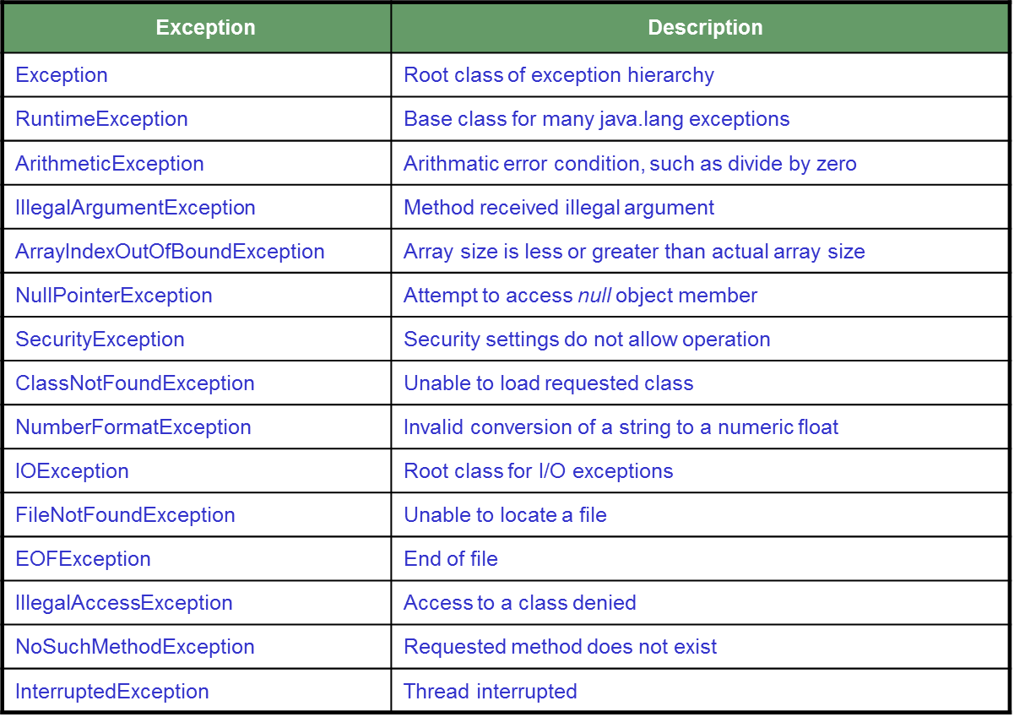
Hierarchy of Exception classes

Slide 51
Summary
Inheritance allows the creation of hierarchical classifications.
Inheritance allows the reusability of code.
All methods and properties of the base class are inherited by objects of the derived class except the constructors.
Exceptions provide for building robust code.
Developers can build their own custom exception.
Generics provides for high level abstraction and code resuability.
Erasure is a Process of removing the generics.

Slide 52
Summary
Abstraction is ignoring the data that is not required and concentrating only on data relevant to the application.
Encapsulation is the process of hiding the implementation details of an object from its user.
Access specifiers are used to determine how the class members are accessed.
Some of the method modifiers in Java are static, final, abstract.
Interface is a contract for class to provide certain functionality without telling about its implementation.

